Slide 1
FELINE LEUKEMIA VIRUS (FeLV)

Slide 2

What is FeLV?
Feline leukemia virus (FeLV), is a retrovirus that is associated with both neoplastic and nonneoplastic (immnosuppressive) diseases. The virus does not live more than a few hours outside a cats body unless it is in a moist environment. The virus begins with an acute virema followed by an asymptomatic phase. FeLV is distributed worldwide. FeLV is in the family Oncovirinae. Many other diseases are caused by oncoviruses including degenerative, proliferative, and feline sarcoma virus. FeLV enters the cat’s body though oronasal inoculation and travels to the oropharyngeal lymph tissue for viral replication. FeLV is a major envelope glycoprotein. protein is used to bind to target cells.The virus binds to T lymphocytes.

Slide 3
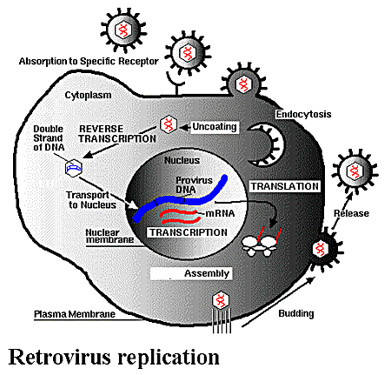

Slide 4
Etiology cont……
There are 3 main subtypes of FeLV. FeLV-positive cats can be infected with one, two, or all three types:
FeLV-A occurs in all FeLV-infected cats and is efficiently transmitted among cats. It causes severe immunosuppression,
FeLV-B occurs in about 50% of all FeLV-infected cats. FeLV-A & FelV-B together are more frequently associated with neoplastic diseases more often than in cats infected only with FeLV-A.
FeLV-C occurs in about 1% of FeLV-infected cats. Is strongly associated with development of erythroid hypoplasia and severe anemia.

Slide 5
HISTORY
FeLV was first discovered by Oswald Jarrett in Scotland in 1964.
Later in 1968 Gordon Theilen tested FeLV at University of California.
A D.V.M Dr. Hardy suggested that cates who had FeLV should be euthanized in order to stop the spread, He also suggested the possibility that the virus could cause leukemia in man,
but another D.V.M, Dr. Murray Gardner have ran repeated test which all fail to give any signs of human infection with FeLV.

Slide 6
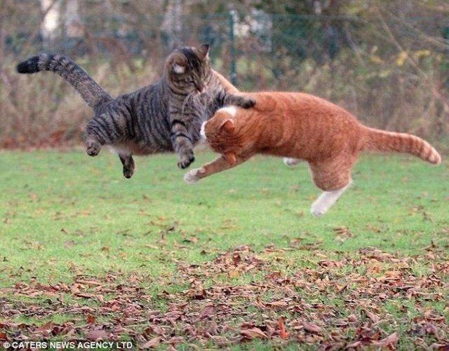
?
How FeLV Transmitted
Vertically
from an infected mother cat to her kittens, either before they are born in the uterus or while they are nursing.
OR
Horizontally
Secretions and excretions
Saliva
Urine
Tears
Through fighting, by bites and scratches
Mutual grooming
Although rarely, spread by contaminated food bowls, water bowls, or even litter pans

Slide 7
Clinical signs
  Loss of appetite, so therefore anorexia
  anemia
  Persistent diarrhea
  vomiting
  weight loss
  Poor coat condition
  fever
  Pale gums and other mucus membranes
  Lymphadenomegaly (enlarges lymph nodes)
  Gingivitis (inflammation of the gums)
  Stomatitis (inflammation of the mouth)
  Skin infections
  upper respiratory tract
  Conjunctivitis
  Seizures
  behavior change
  neurological disorders
  Keratitis
  Can even cause abortion

Slide 8
Signalment
FeLV can affect any age sex or breed of cats
Even so, Kittens are at greater risk to exposure and infection than adult cats.
Infection rates are at highest in catteries or multi cat households.

Slide 9
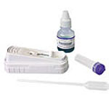
Diagnostic Test
.
  ELISA (enzyme-linked immunosorbent assay) a screeningtest test. it detects both primary and secondary stages of viremia.
  IFA (indirect immunofluorescent antibody assay) Test positive. IFA tests detect secondary viremia only.
  Vaccination for FeLV does not affect test results since the tests are for viral antigens, not antibodies

Slide 10
Recommended Treatment
NO CURE!
Even though its not curable you should still do therapy and vaccinate for longer living and improving clinical signs
Treatment is focused on manintaing the cats health and help stop the futher secondary infections.
Most infected cats are persistently viremic by the time infection is diagnosed.

Slide 11
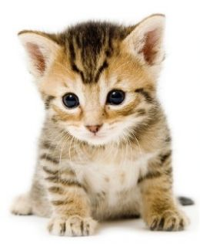
is your cat protected?

Slide 12

PREVENTION
The only sure way to protect cats is to prevent their exposure to FeLV-infected cats.
Keep cats indoors
Keep cats away from infected cats that might bite them.
If you do allow your cats outdoor access, provide supervision or place them in a secure enclosure to prevent wandering and fighting.
  don't allow infected cats to share food and water bowls or litter boxes with uninfected cats.
clean and disinfect or replace food and water dishes, bedding, litte prans and toys.

Slide 13
CLIENT EDUCATION
  If you do allow your cats outdoor access, provide supervision or place them in a secure enclosure to prevent wandering and fighting.
If planning to get a new cat, properly vaccinated before entering the household.
Remember you should schedule wellness visits with your veterinarian at least once every six months
Closely monitor the health and behavior of your FeLV-infected cat. Alert your veterinarian to any changes in your cat's health immediately.

Slide 14
FACTS
Cats who can roam freely outdoors the prevalence of FeLV as high as 70%
Cats roaming in urban area are exposed to FeLV 4% than cats roaming in rural area 6%
50% of virema cats die within 1 year of FeLV infections
83% of apparently healthy cats with FeLV infection will die within 3.5 years of viral detection.

Slide 15
REFRENCES
WWW.VET.UGA.EDU
WWW.IDEXX.COM
WWW.VET.COTNELL.EDU
WWW.WINNFELINEHEALTH.ORG
WWW.ANIMALHEALTHFOUNDATION.NET

